Slide 1
Predicting Loan Default Risk Using Customer Financial Profiles
DSC 680 – Applied Data Science, Fall 2025
Presented by Serge Nane

Slide 2
Introduction
Key point: Loan default is a major financial risk impacting profitability and stability for lending institutions.
Goal: This project applies machine learning to predict loan default probability using customer demographic and financial indicators to enable more informed credit decisions.
Stakeholders: The project is relevant to banks, credit unions, and financial analysts seeking to improve risk assessment, reduce defaults, and optimize lending strategies.

Slide 3
Data Overview
Dataset: LendingClub Loan Default Prediction Dataset (Kaggle).
Contains: 255,347 loan records with 17 features, including age, income, loan amount, credit score, interest rate, employment length, and loan purpose.
Target Variable: Binary outcome (0 = non-default, 1 = default).
Challenge: The dataset is imbalanced (~11.6% default cases).

Slide 4
Data Preparation
Data Cleaning: Removed unique loan identifiers and converted "Yes"/"No" binary fields to numerical values.
Feature Scaling: Continuous numerical features were standardized for model consistency.
Balancing: SMOTE (Synthetic Minority Oversampling Technique) was applied to address class imbalance and improve model recall for the minority class.

Slide 5
Exploratory Insights
Correlation analysis revealed Age, Interest Rate, and Income as the strongest predictors of loan default.
Default rate analysis showed unemployed applicants and business loans have the highest risk.
The dataset shows a significant class imbalance with far more non-default cases.

Slide 6
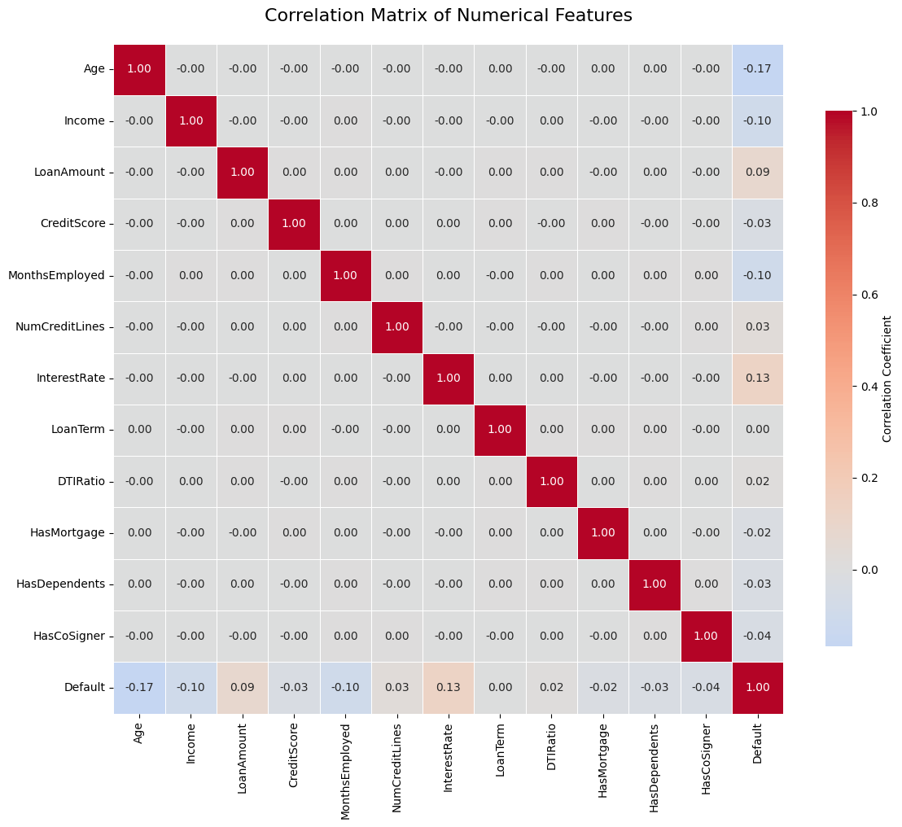
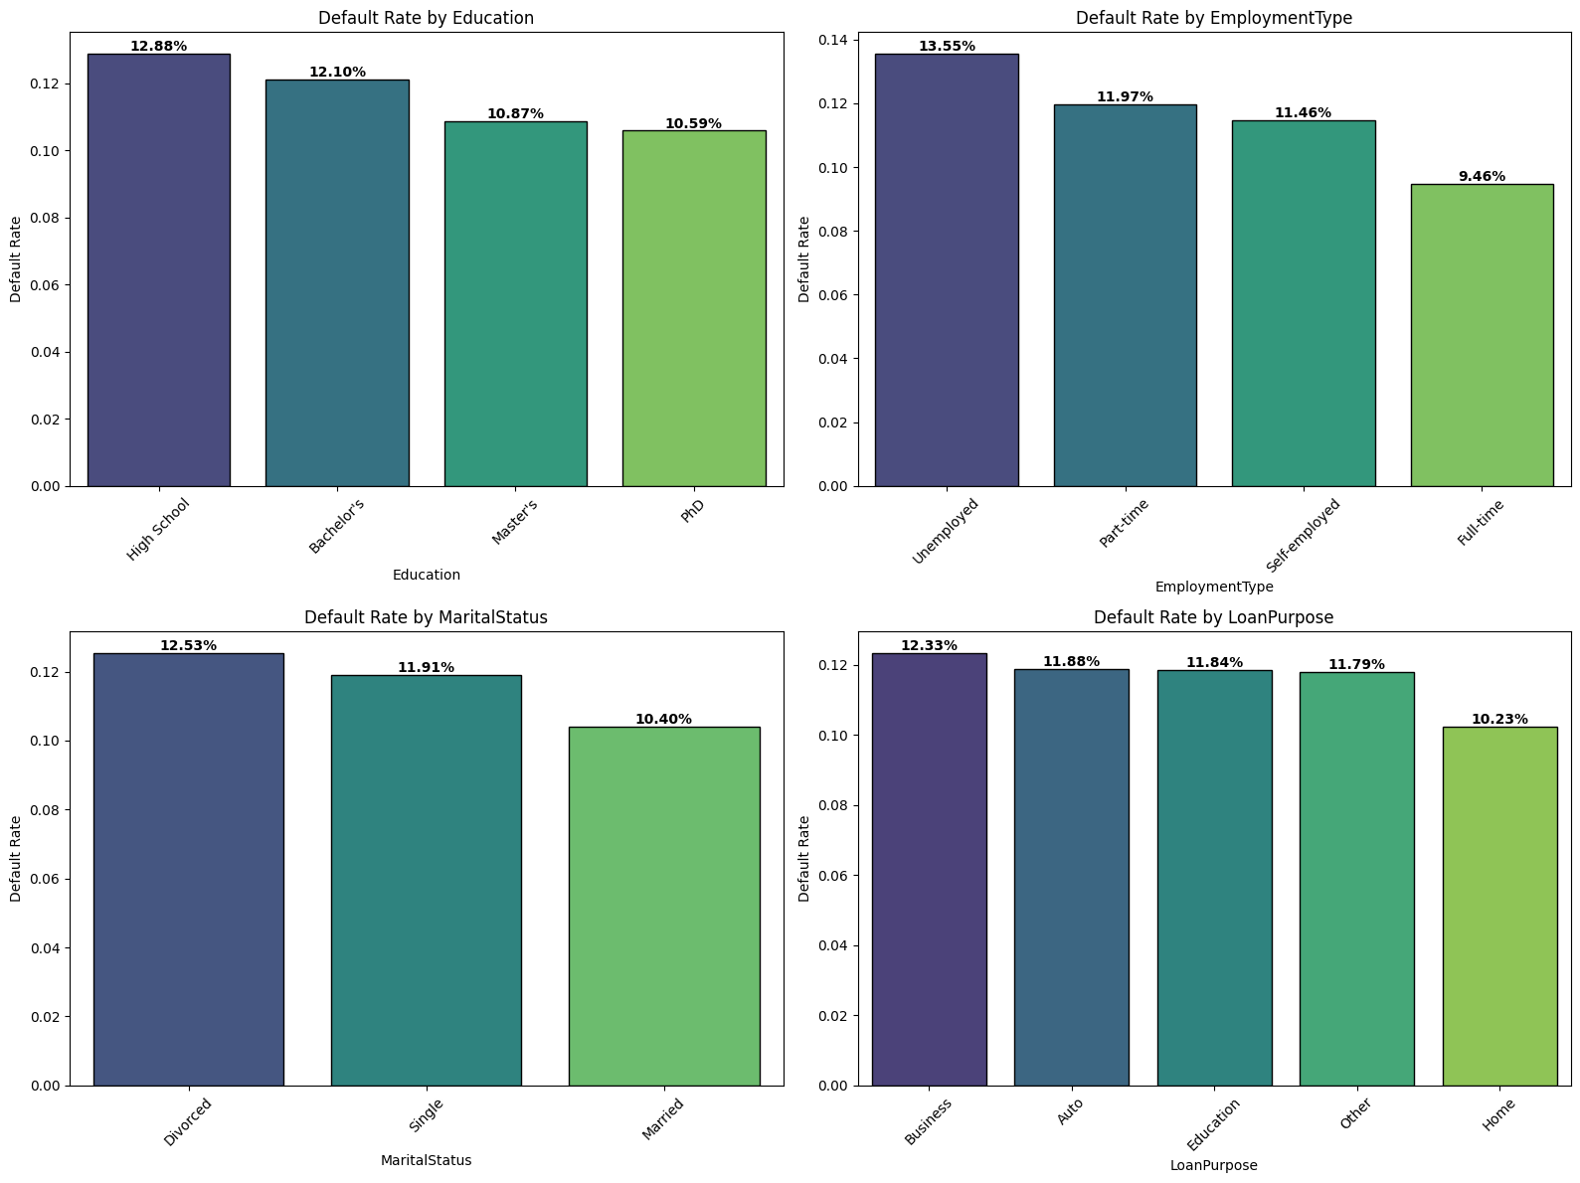
EDA VISUALS

Slide 7
Modeling Approaches
Logistic Regression: Provided an interpretable baseline model with clear coefficient analysis.
Random Forest: Ensemble method used for handling non-linear relationships and feature interactions.
Model Comparison: Focused on precision-recall trade-off to determine the most business-appropriate model.

Slide 8
Results Summary
Logistic Regression demonstrated superior recall (0.70), correctly identifying 70% of actual defaulters.
Random Forest showed higher accuracy (0.88) but poor recall (0.09), missing most defaulters.
Business Conclusion: Logistic Regression is more valuable for risk mitigation despite lower accuracy.
Model | Accuracy | Precision | Recall | ROC-AUC
Logistic Regression | 0.68 | 0.22 | 0.70 | 0.753
Random Forest | 0.88 | 0.46 | 0.09 | 0.735

Slide 9
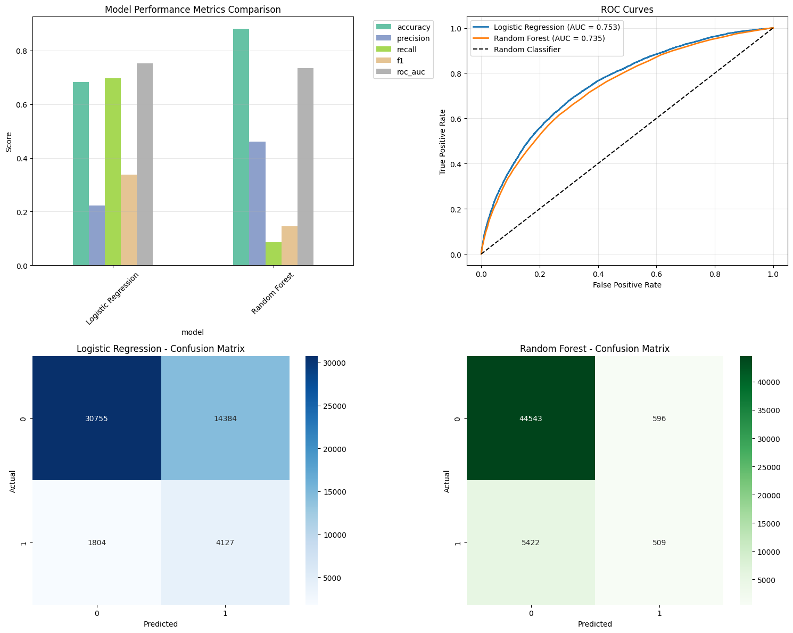
Visualizations

Slide 10
Feature Importance
Both Models Agreed on key predictors: Age, Interest Rate, Months Employed, and Income.
Logistic Regression provided clear directional insights: younger age, higher interest rates, and shorter employment increase default risk.
Business Insight: Financial stability and affordability are the primary drivers of loan repayment.

Slide 11
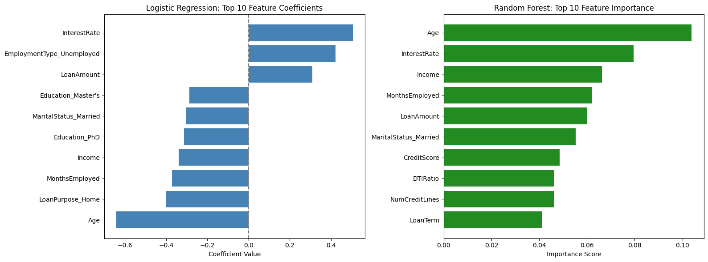
Visualizations

Slide 12
Conclusion
Logistic Regression is recommended as the most practical model due to its high recall and interpretability.
Key predictors include Age, Interest Rate, Employment Stability, and Income.
Limitations: Model performance trade-offs between false positives and false negatives.
Future work: Include threshold tuning, test XGBoost, and incorporate economic factors.

Slide 13
Ethical Considerations
Data Privacy: Customer financial data must be handled with strict confidentiality and compliance.
Fairness: Models must be monitored for potential bias against specific demographic groups.
Interpretability: Logistic Regression provides transparent decision-making criteria for regulatory compliance.
Responsible Use: The model supports but does not replace human judgment in loan approval decisions.

Slide 14
Thank You!

